Slide 1
Kubernetes Fundamentals
Concepts and Labs
John Ragan
Hobsons, Inc.

Slide 2
Kubernetes Fundamentals
Lab Setup

Slide 3
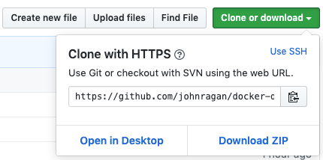
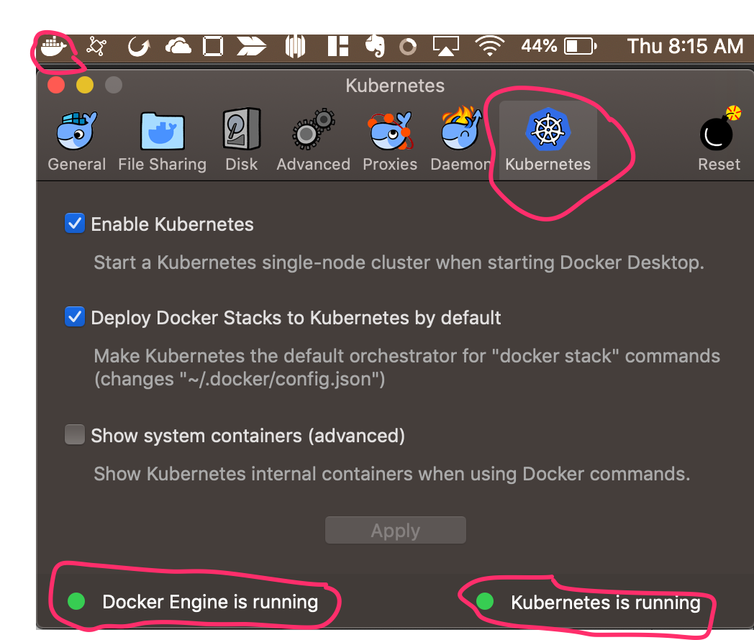
Lab Setup
Setting aside first 15 minutes to get things installed
As soon as you see this, please get started ASAP! ☺
Go to my GitHub main page below for links and so forth
Install Docker Desktop Community version
Stable, not Edge! Version 2.0.0.3, Engine: 18.09.2
Has support for single node Kubernetes built in
Enable in Docker Preferences; configure as on right
Both the Engine and Kubernetes should show running
Older Docker versions may not have this
If not, please uninstall and reinstall
Then run these commands:
docker pull mhart/alpine-node:4.9.1
docker pull mhart/alpine-node:6.17.1
Can take some time to pull down…
Docker and GitHub for the labs
https://github.com/johnragan/docker-demo-101 (clone this now)
git clone https://github.com/johnragan/docker-demo-101.git

Slide 4
Kubernetes Fundamentals - Objectives
Docker basics - review
Understand basic problems Kubernetes solves
Solve these problems hands on along the way via labs
Understand Kubernetes components and interactions
You may want to pair program if your install is not working
If your install does not work, you will still get a lot out of this session
Each lab is independent
working-code folder

Slide 5


Who Has a Thumb and Likes Kubernetes? This Guy!
Hobsons Engineering VP – Intersect
We are an EdTech Company richly represented in US education
Naviance – 40% of US HS students – Career, College and Life Readiness
Starfish – 25% of US College Students – Advising and Alerting
Intersect – aligning College class needs with student fit
Intersect as a Product
Written from scratch 3 years ago
Node, React, AWS, ElasticSearch, MongoDB, GraphQL
CI/CD, deep automated testing, linting – kept up to date
Mesos to Kubernetes
We are hiring
Lead and Senior Node/React developers
DevOps
John Ragan

Slide 6
Kubernetes Fundamentals
1 - Docker Basics

Slide 7
Docker Containers
The old way
Linux package manager to install packages (Node, MongoDB) on target servers
Apply package configuration changes
Copy application executable code and configuration to target servers
Hope
All packages installed
Configurations are correct
Versions are correct
Everything works together
What could go wrong? Environmental mismatches are fun!
High coupling since dependent on many packages being properly installed

Slide 8
Docker Containers
What the cool kids are doing!
Install Docker on target servers
Build Docker images that encapsulate package (Node), configuration and code
Load up to DockerHub
Pull Docker images from DockerHub to target servers
Docker will take care of
Installations
Versioning
Configurations
Application code
No more environmental mismatches!
Low coupling since sole dependency is Docker itself

Slide 9
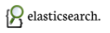






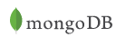

Why Docker?
Run containers anywhere Docker installed

Slide 10
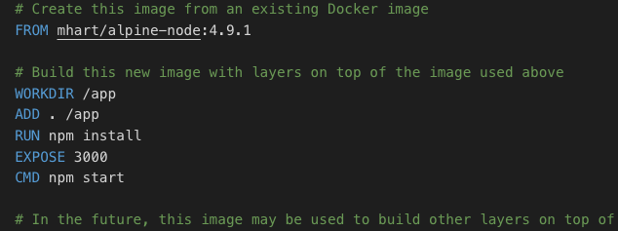
Why Docker?
Layer in functionality to create more complex images from existing images
Node Javascript code

Slide 11
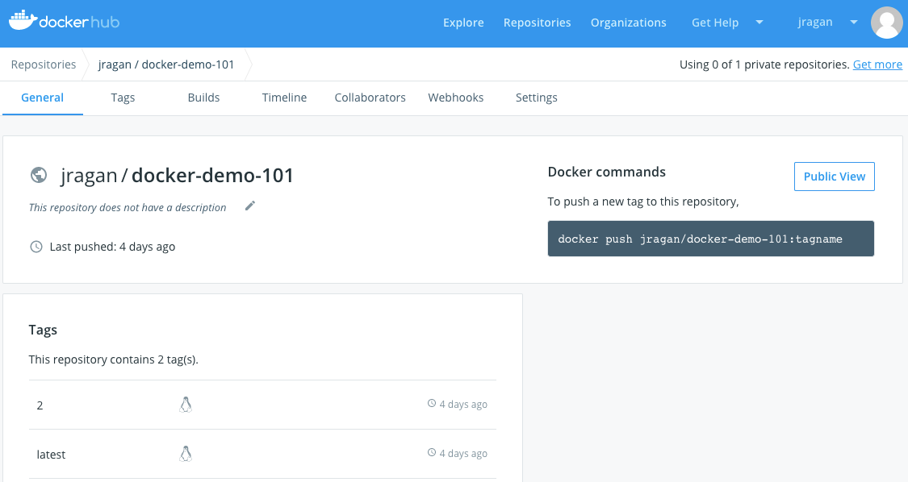
Why Docker?
DockerHub to obtain/store images for reuse
Isolated and easily removed
Notes:
Docker images for our server components that we build
Avoid building up Cruft

Slide 12
Docker – Lab 1
Create Docker account
Go into the downloaded lab’s working-code/lab-1-docker directory
Build Image from Dockerfile
Run the Image
Upload the image
Change it to use Node version 6.17.1 and say “Hello DevFest DC” (index.js file)
Upload Image to your DockerHub as version 2
http://github.com/johnragan/docker-demo-101
https://cloud.docker.com/u/jragan/repository/docker/jragan/docker-demo-101

Slide 13
Dockerfile is not Image is not Container
Dockerfile is a text file
Image is built from a file but is not what is actually running
One or more Containers are executing instances of Images

Slide 14
Docker Image is not VM Image
Many Docker Containers can run on single OS
Leverage Linux Containers (Linux Kernel feature) to isolate within a single OS

Slide 15
Kubernetes Overview
2 - Components and Interactions

Slide 16
So You Have a Bunch of Docker Containers – Now What?
All your problems are solved!

Slide 17
So You Have a Bunch of Docker Containers – Now What?
Which servers are you going to run them on?
How are going to put not too many but not few on each server?
How will you orchestrate all of your app’s containers, as well as all the other apps you need to deploy and run?
How will you expose your services to the world, and restrict access?
How will you set up scalability?
How will you restart failed components automatically?
How will you pause components from serving requests when not ready?
How will you pass in secrets?
How will you pass in configurations?
How will you automatically scale up and down based on metrics?
How will you rollback deployments?
How will you label and control what gets run where?

Slide 18
Kubernetes Overview
Manages containerized apps across a cluster
Long running applications
Jobs
Stateful or Stateless
Manages container lifecycle
Start
Restart if dies
Schedule onto certain server nodes
Open source
Google

Slide 19
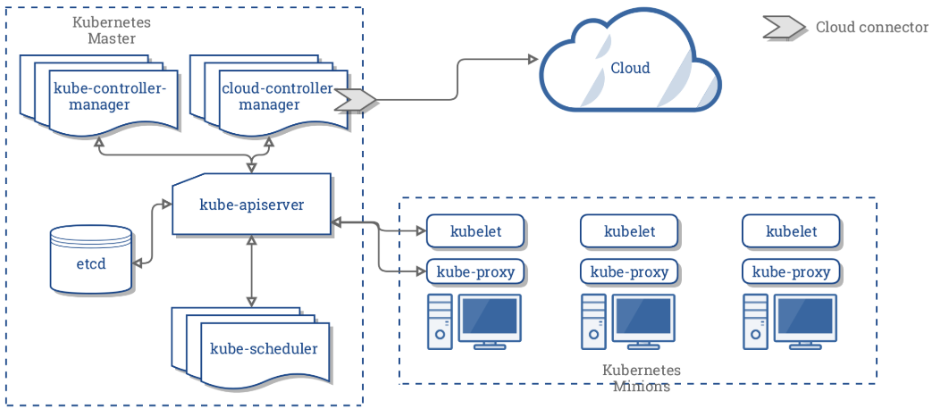
Kubernetes Cluster – Generic Container Running Cluster

Slide 20
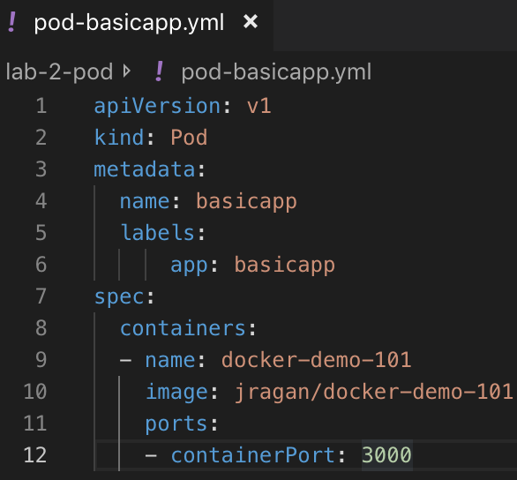
Lab 2 – Creating and Exposing a Pod
Create basic Pod definition
Use kubectl to create the pod on cluster
Expose it
Access it (use the exposed port!)
Delete the service and pod to shut down

Slide 21
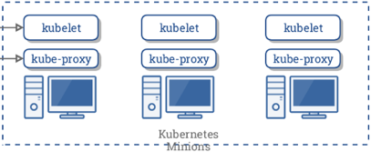
Pods
Pods group containers that work together
Same lifecycle
Same worker node
Assign containers to pods, which are assigned to worker nodes
Pod is not Worker Node
Worker Node part of Kubernetes physical cluster of machines (physical)
Pods group container nodes to run on Worker Nodes (application logical)
Should you use Pods for horizontal scaling?

Slide 22
Why Kubernetes?
Which servers are you going to run them on?
How are going to put not too many but not few on each server?

Slide 23
Kubernetes Fundamentals
3 - Working with the Deployment Objects

Slide 24
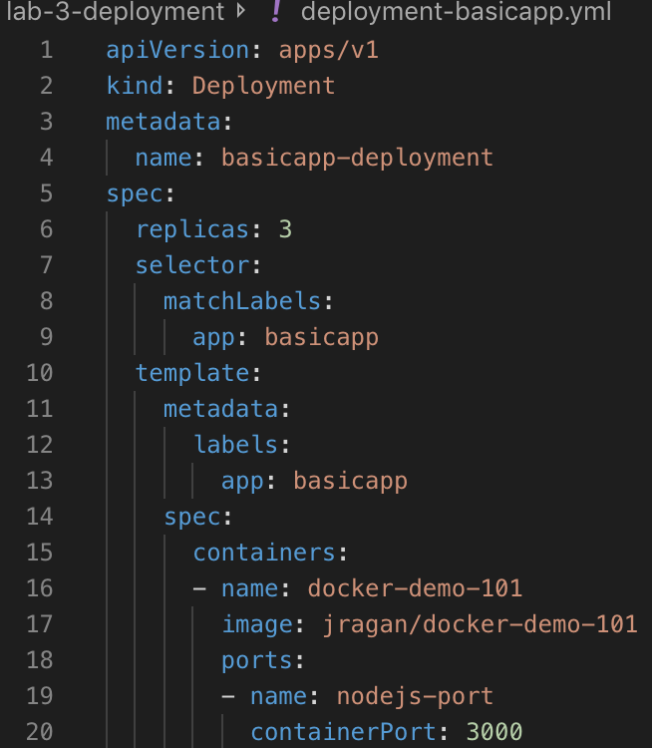
Your Application Likely Has Lots of Containers
Who wants to deploy each Pod one by one?
Including for each replica for scalability
Instead, specify via a Deployment Object
Specify the containers to deploy
Specify replicas for scalability (rich filtering)
Apply updates all at once
Do rolling updates
Do rollbacks
Specify how you want it to end up
Kubernetes figures out how to make it happen

Slide 25
Lab 3 – Creating a Deployment Object
Create a Deployment definition
Use kubectl to create the deployment on cluster
Expose it
Access it (use the exposed port!)
Delete the service and deployment to shut down

Slide 26
What Did We Do?
Simple Example
Limited to a single container
A typical deployment would be a lot more complicated
Node containers
MongoDB containers
ElasticSearch
A whole lot of other stuff

Slide 27
Why Kubernetes?
Which servers are you going to run them on?
How are going to put not too many but not few on each server
How will you orchestrate all of your app’s components, as well as all the other apps you need to deploy and run?

Slide 28
Kubernetes Fundamentals
4 - Working with the Service Objects

Slide 29
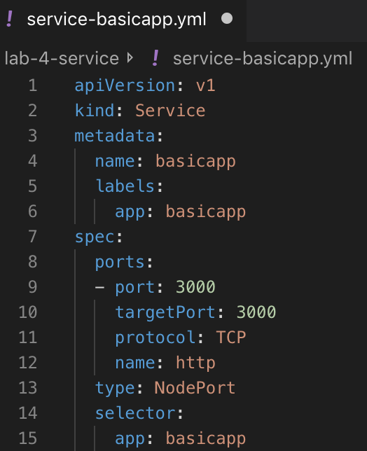
Exposing Services to the Outside World
Who Likes Typing kubectl expose pod basicapp-deployment-689979c749-7dbfs --type=NodePort --name basicapp?
I do not!
Instead, let’s use Service Objects
Have the logic to expose for external access
Pods are constantly being created and destroyed
Failover and recovery
Scaling operations
New deployments
Services are more permanent

Slide 30
Lab 4 – Service Object
Create a Service definition
Use kubectl to create the deployment and service on cluster
Access it
Delete the service and deployment to shut down

Slide 31
Why Kubernetes?
Which servers are you going to run them on?
How are going to put not too many but not few on each server
How will you orchestrate all of your app’s components, as well as all the other apps you need to deploy and run?
How will expose your services to the world, and restrict access?

Slide 32
Kubernetes Cluster – Generic Container Running Cluster

Slide 33
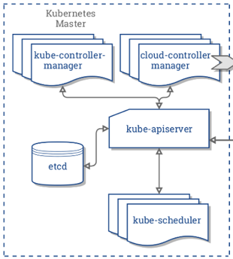
Master Node Responsibilities

Slide 34
Worker Node Responsibilities

Slide 35
Kubernetes Fundamentals
5 - Scaling

Slide 36
Scaling
Scaling Objects up and down
Edit Deployment object
HPA
Specify how you want it to end up
Kubernetes figures out how to make it happen

Slide 37
Lab 5 – Scaling
Edit Deployment to Increase Replication by 3 and then decrease by 2

Slide 38
Why Kubernetes?
Which servers are you going to run them on?
How are going to put not too many but not few on each server?
How will you orchestrate all of your app’s components, as well as all the other apps you need to deploy and run?
How will expose your services to the world, and restrict access?
How will you set up scalability?

Slide 39
Kubernetes Fundamentals
6 - Health Check and Readiness Check, Attaching to a Pod

Slide 40
Health Checks and Readiness
Health Checks
Though Pod is still running, your service can fail
You don’t want it to fail silently
Health checks allow automatic restart at failures
Readiness Checks
Some services require initialization activities before they can start
They may be require other state to be able to handle requests
You want to be able to hold off on having your service start until ready
You want to automatically take it out of the pool and place back according to readiness
Three Ways
HTTP GET path return code
TCP check
Run command to check health

Slide 41
Lab 6 – Health Check, Readiness, Attaching
Play with experiment-liveness-readiness.yml’s 3 scenarios of liveness and readiness
Attach to a pod and examine index.js to see what is assigned to var app

Slide 42
Why Kubernetes?
Which servers are you going to run them on?
How are going to put not too many but not few on each server?
How will you orchestrate all of your app’s components, as well as all the other apps you need to deploy and run?
How will expose your services to the world, and restrict access?
How will you set up scalability?
How will you restart failed components automatically?
How will you pause components from serving requests when not ready?

Slide 43
Kubernetes Fundamentals
7 - Secrets

Slide 44
Secrets
Secrets can be passed in via Kubernetes own Secrets system
External Docker image (do not store publicly)
Environment variables
Volumes with files
Other ways
We will demonstrate
Volume with files
Environment variables
Main steps
Generate the secrets into base64
Read the secrets in
Create the environment variables
Add volume mounts and volumes to deployment

Slide 45
Lab 7 – Secrets
Create a secret from db-secrets file
Create and run a deployment using those secrets
Read the secrets from /etc/creds
Read the secret from the environment variables
Display the contents of the secrets as volumes

Slide 46
Why Kubernetes?
Which servers are you going to run them on?
How are going to put not too many but not few on each server?
How will you orchestrate all of your app’s components, as well as all the other apps you need to deploy and run?
How will expose your services to the world, and restrict access?
How will you set up scalability?
How will you restart failed components automatically?
How will you pause components from serving requests when not ready?
How will you pass in secrets?

Slide 47
Kubernetes Fundamentals
8 - Auto Scaling

Slide 48
Auto Scaling via Metrics
If scaling by metrics, have to install something to track metrics
Installed metrics_server
Was a little a tricky, so will demo this but leave notes for you to do yourself later
Based on usage metrics, will scale up or down automatically
Polls every 30 seconds (changeable)
Our example is % CPU utilization
Other resource levels can be used
We will target 50%
200m CPU, which is 20% of CPU
We will set up 1 to 6 Pods
Will automatically scale up or down depending on CPU usage to hit target

Slide 49
Lab 8 – Auto Scaling via Metrics Server
Configure auto scaling based on CPU metrics
Increase CPU load to increase more Pods auto-created
Decrease CPU load to decrease Pods auto-created

Slide 50
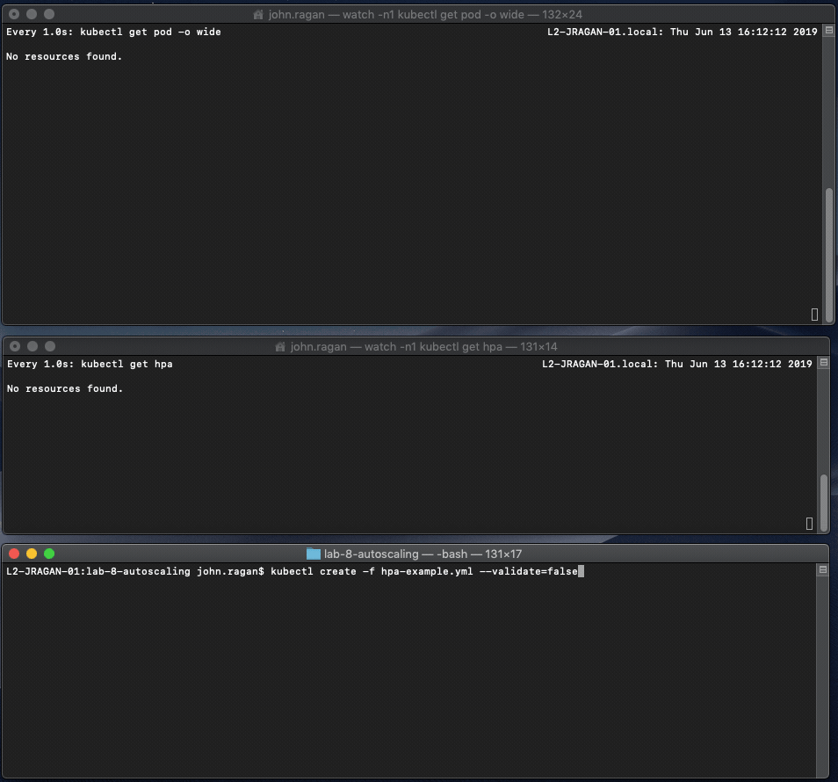

Slide 51
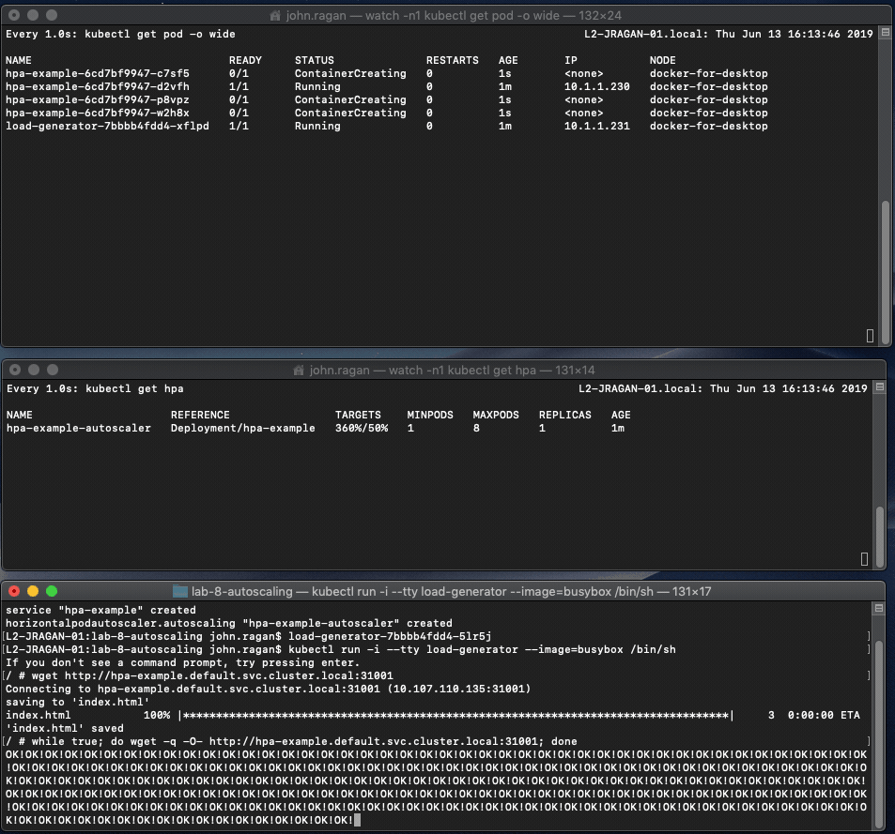

Slide 52
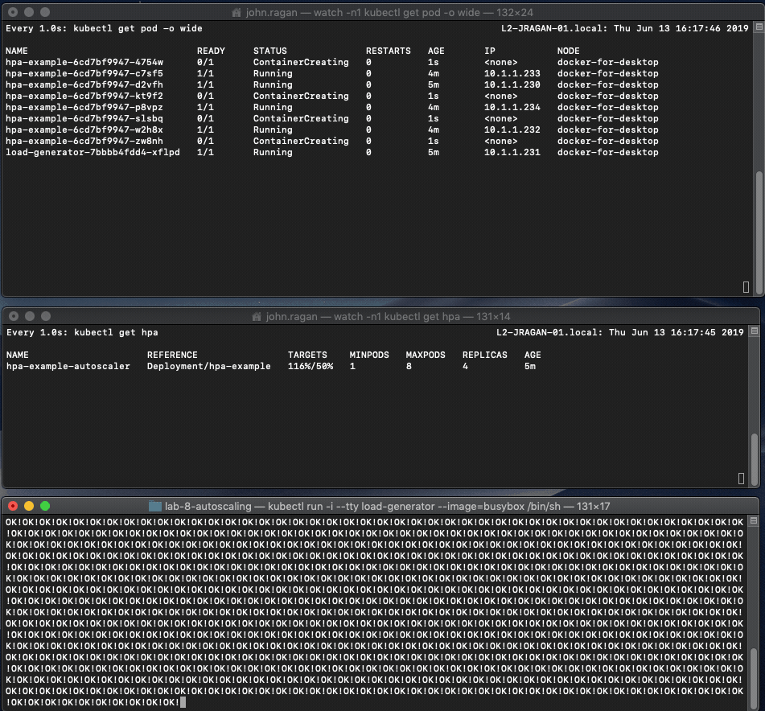

Slide 53
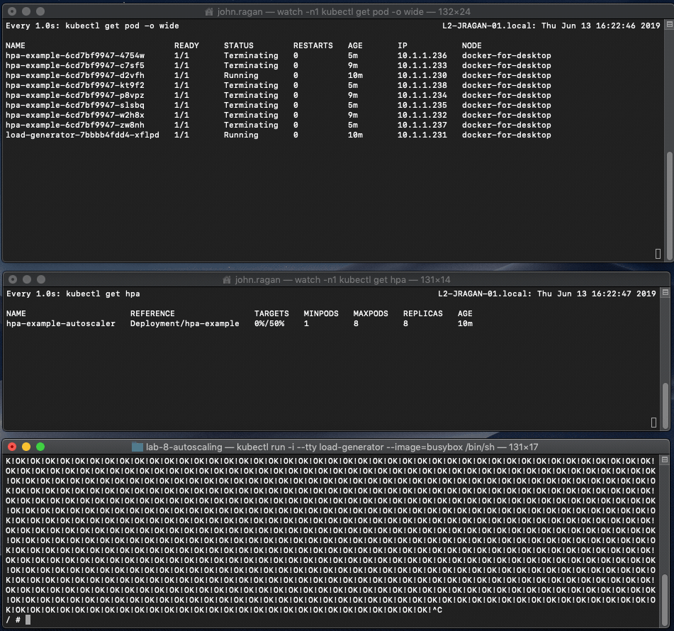

Slide 54
Why Kubernetes?
Which servers are you going to run them on?
How are going to put not too many but not few on each server?
How will you orchestrate all of your app’s components, as well as all the other apps you need to deploy and run?
How will expose your services to the world, and restrict access?
How will you set up scalability?
How will you restart failed components automatically?
How will you pause components from serving requests when not ready?
How will you pass in secrets?
How will you automatically scale up and down based on metrics?

Slide 55
Kubernetes Fundamentals
9 - ConfigMap

Slide 56
ConfigMap
Configurations can be passed in via ConfigMaps in a number of ways
Full configuration file
Environment variables
Volumes
Command line argument
We will demonstrate using a full configuration file
Simple and more complex expressions
Main steps
Create the configuration file
Add volume mounts and volumes to deployment
Read the properties from the file created in the Pod

Slide 57
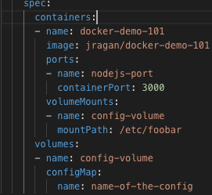
Lab 9 – ConfigMap
Create the deployment file to configure the volumeMount ‘config-volume’ to mount to /etc/config
Update the deployment file to configure the volume ‘config-volume’
Display the contents of app.properties in one of the Pods

Slide 58
Why Kubernetes?
Which servers are you going to run them on?
How are going to put not too many but not few on each server?
How will you orchestrate all of your app’s components, as well as all the other apps you need to deploy and run?
How will expose your services to the world, and restrict access?
How will you set up scalability?
How will you restart failed components automatically?
How will you pause components from serving requests when not ready?
How will you pass in secrets?
How will you automatically scale up and down based on metrics?
How will you pass in configurations?

Slide 59
Kubernetes Fundamentals
10 - Rollback

Slide 60
Rolling Back and Changing Versions
You can change the Docker image your Deployment is running
Grab a different image and version from DockerHub
Rollback
You can undo to go the previous Docker image you had
You can also undo to a particular revision
History
You can view the history of your deployments and changes

Slide 61
Kubernetes Fundamentals
Interactive Demo – Rollback

Slide 62
Lab 10 – Rollback
View rollout status
View rollout history
Rollback a deployment
Rollout to a particular version

Slide 63
Why Kubernetes?
Which servers are you going to run them on?
How are going to put not too many but not few on each server?
How will you orchestrate all of your app’s components, as well as all the other apps you need to deploy and run?
How will expose your services to the world, and restrict access?
How will you set up scalability?
How will you restart failed components automatically?
How will you pause components from serving requests when not ready?
How will you pass in secrets?
How will you automatically scale up and down based on metrics?
How will you pass in configurations?
How will you rollback deployments?

Slide 64
Kubernetes Fundamentals
11 - Label and NodeSelector

Slide 65
Labels and Label Selectors
Labels are key values pairs
Tag however you wish
Can use Label Selectors to match labels and filter
Simple and more complex expressions
Node Selectors
Limits what pods or services can run on a specific node
Label your nodes
Use Node Selectors to pods to restrict the nodes they can run on

Slide 66
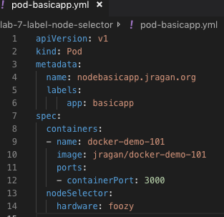
Lab 11 – Label and Node Selector
Launch Pod to only be able to run on a Node where Env:Production
Demonstrate its failure to launch
Make the necessary changes to allow it to run

Slide 67
Why Kubernetes?
Which servers are you going to run them on?
How are going to put not too many but not few on each server?
How will you orchestrate all of your app’s components, as well as all the other apps you need to deploy and run?
How will expose your services to the world, and restrict access?
How will you set up scalability?
How will you restart failed components automatically?
How will you pause components from serving requests when not ready?
How will you pass in secrets?
How will you automatically scale up and down based on metrics?
How will you pass in configurations?
How will you rollback deployments?
How will you label and control what gets run where?

Slide 68
Kubernetes Fundamentals
Review

Slide 69
Why Docker?
Run containers anywhere Docker installed
Can run container functionality without knowing/installing the internals
Layer in functionality to create more complex containers from existing images
DockerHub to obtain/store images for reuse
Build and push containers around vs. configuring package installs then layering code and configuration
Less deltas between the environments
Isolated and easily added/removed

Slide 70
Dockerfile is not Image is not Container
Dockerfile is a text file
Image is built from a file but is not what is actually running
One or more Containers are executing instances of Images

Slide 71
Why Kubernetes?
Pod/Scheduler/Controller. Which servers are you going to run them on?
Pod/Scheduler/Controller. How are going to put not too many but not few on each server?
Deployment. How will you orchestrate all of your app’s components, as well as all the other apps you need to deploy and run?
Service. How will expose your services to the world, and restrict access?
Deployment Replicas. How will you set up scalability?
LivenessProbe. How will you restart failed components automatically?
ReadinessProbe. How will you pause components from serving requests when not ready?
Secret. How will you pass in secrets?
HorizontalPodAutoscaler. How will you automatically scale up and down based on metrics?
ConfigMap. How will you pass in configurations?
Rollout. How will you rollback deployments?
Labels/NodeSelectors. How will you label and control what gets run where?

Slide 72
Kubernetes Components
Master Node
API Server
Etcd
Scheduler
Controller
Worker Node
Pod with Containers
Kubelet
Kube-proxy
Logical Entities
Deployment
Service
Secret
ConfigMap

Slide 73
Thank
You!

